Slide 1
PAWS Navigation: Reinforcement Learning for Path Planning in Unknown Environments
Samantha Johnson
University of Maryland, College Park
ENPM690 – Robot Learning

Slide 2
PAWS (Psychological Assistance and Wellness System)
“Hypothetical” robot that has been researched and designed over graduate education
In-home mental health robotic pet companion
Navigation is a crucial component
Needs to quickly navigate to the human’s location and avoid obstacles
The environment is unknown

Slide 3
Machine Learning and Path Planning
Path planning in unknown environments is not a capability common to most path planning algorithms
Most require a map of the area in order to effectively plan
Introducing machine learning can help mitigate the need for a map
Research with promising results using reinforcement learning showing ability to navigate unknown/dynamic terrain and reach a goal
Able to find semi-optimal paths

Slide 4
Algorithm
Utilizing a type of reinforcement learning called Double Deep Q-Network (DDQN)
Features:
Epsilon Greedy Strategy to promote exploration early in the training phase
Experience Replay to reduce correlation between training batches
Target Network to calculate target values and improve estimate
Goals:
Train robot to navigate to a changing goal in an unknown environment
Avoid obstacles
Find a timely path

Slide 5
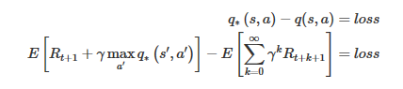
Algorithm
Initialize the environment and agent
Copy the policy network to the target network
For each episode:
Initialize the simulation
For each time in max time:
Select an action based on e-greedy strategy
Random or from neural net
Execute action in simulation environment
Return reward obtained and next state
Store last experience in replay memory
Perform neural net training
Select batch of memories to replay through policy network
Utilize the target net to obtain values for the next state
Calculate the loss between the output Q values and target Q values
Gradient descent to minimize loss
Decay epsilon
After a set time update the target net weights to match the policy net weights
https://deeplizard.com/learn/video/0bt0SjbS3xc

Slide 6
Technologies
CoppeliaSim – simulation software
Python - algorithm
Interfacing with CoppeliaSim via the Remote API
Keras and TensorFlow
Numpy
SciPy

Slide 7
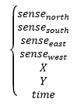
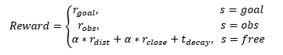
Design
Reward function
Large reward for reaching goal
Moderate negative reward for hitting obstacle
Free space reward
Positive value for moving towards the objective
Higher value being near the objective
Negative value that increases as time passes
State
0 or 1 for detection by proximity sensor
Binned vector between the robot and goal
Normalized time elapsed
Actions
N
S
E
W

Slide 8

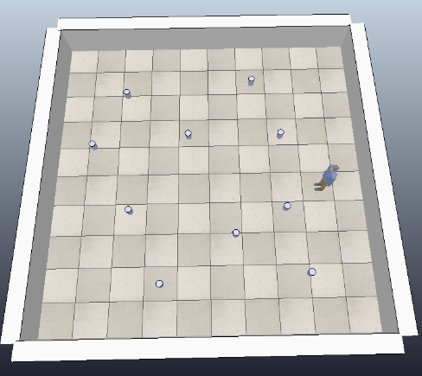
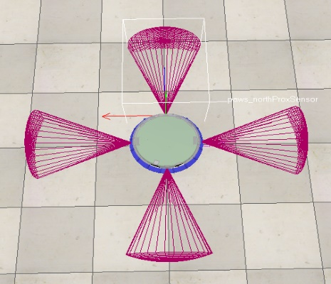
Simulation environment
CoppeliaSim was used as the simulation software
Environment was designed as a planar area containing:
Walls and obstacles
Human marking goal location
Robot was designed as a 2-wheeled mobile robot
4 proximity sensors pointing [N S E W]
Motion constrained to [N S E W] directions

Slide 9
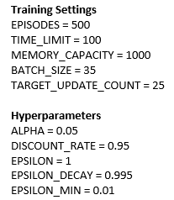
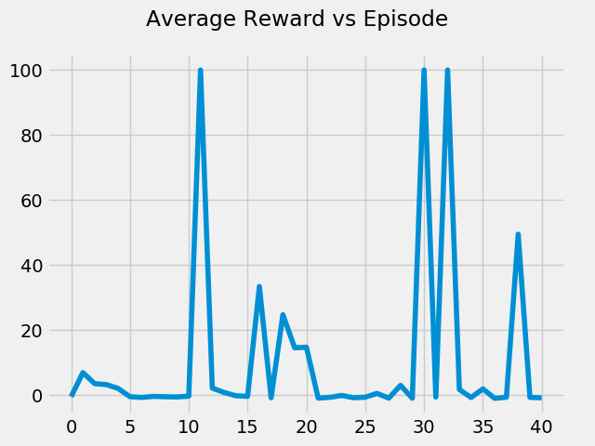
Training
Parameters
Data collection
Distance vs. Time
Error vs. Time
Time vs. Episode
Reward vs. Episode

Slide 10
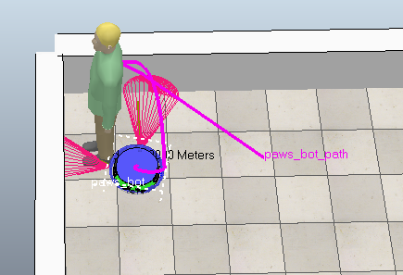
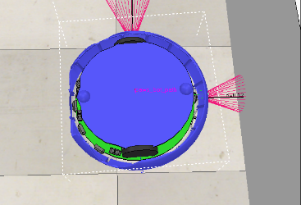
Training Difficulties
CoppeliaSim took several hours to run a couple dozen episodes
~1 hour per 10 episodes
Physics anomalies during reset caused robot to flip upside down
Random and would cause training to stop
Took a long time to observe this happening
Tried to resolve issues via code, but there was little that could be done. Training large numbers of episodes became impossible using this simulation system

Slide 11
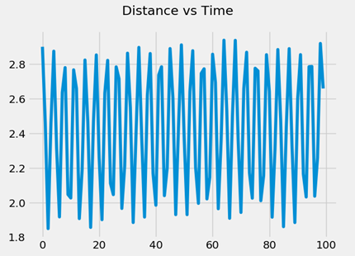
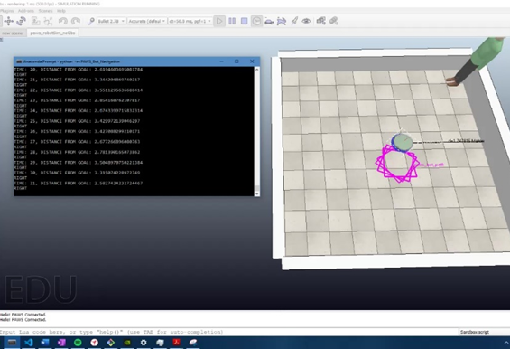
Testing
Tested on max episodes able to train which was 40 episodes
Behavior resulted in going in circles around the central point

Slide 12
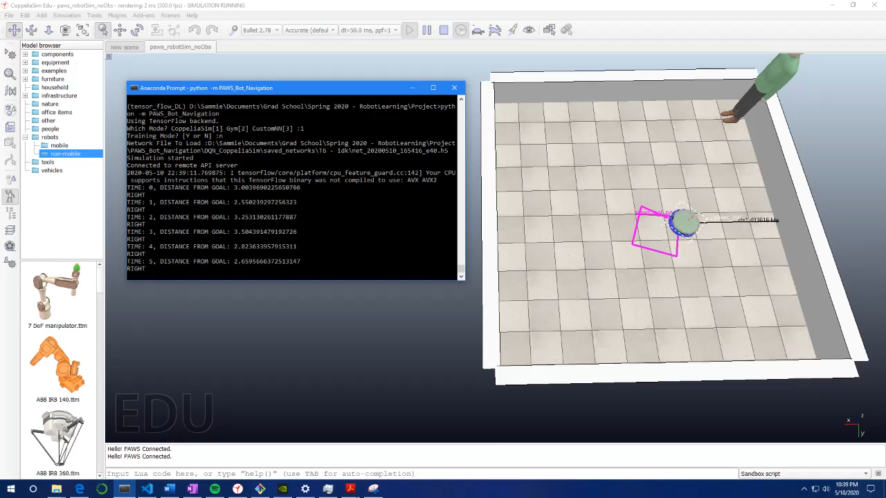

Slide 13
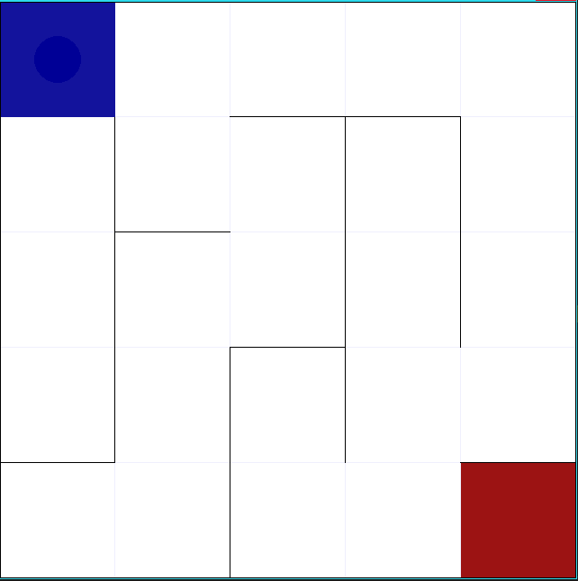
Another approach – Open AI Gym
Implemented Gym as the simulation software instead
Utilized a third-party maze environment called gym-maze
Used originally developed DDQN algorithm
State of Robot is [X, Y] – different from original state
Action Space is [N, S, E, W] – same as original actions
Implemented original reward function (overwriting the one produced by the sim)
Goal location static
https://github.com/MattChanTK/gym-maze

Slide 14
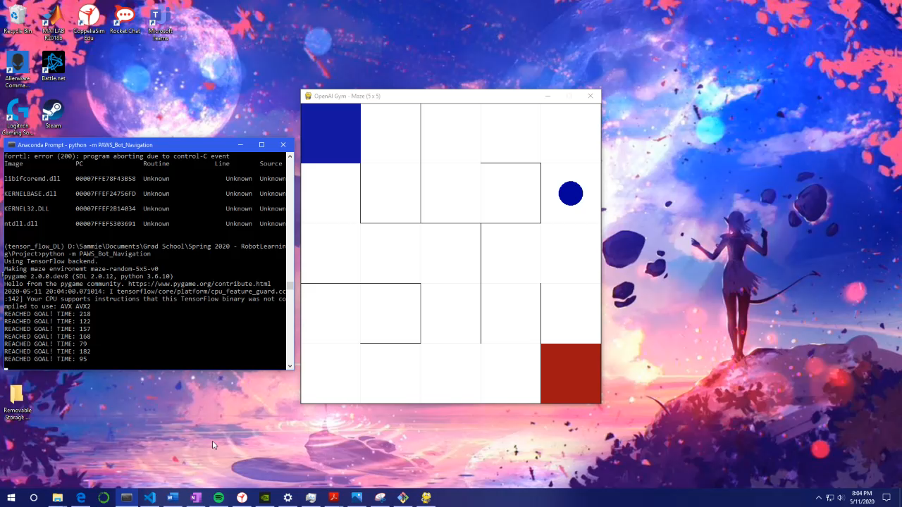
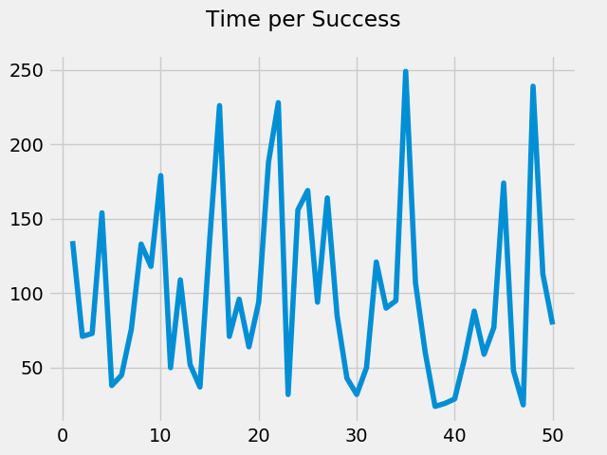
Testing – open ai gym
Trained 1000 Episodes with a Time Limit of 250
50 % Success rate

Slide 15
Conclusions
CoppeliaSim was a bad choice for the training environment
Too long too complete steps
Dynamics makes it hard to reset environment
State space may have been too large for reasonable training time
Binning the distance vector helped to emulate grids, but there were still a lot of possible states
Reward function was successful during training in the Gym environment
Promising result for further work
Future work to implement the intended environment in Gym to allow for 10K+ trainings which should help the original solution converge

Slide 16
sources
Lei, X., Zhang, Z. & Dong, P. Dynamic Path Planning of Unknown Environment Based on Deep Reinforcement Learning. Journal of Robotics 2018, 1–10 (2018).

